Slide 1
PIC and FLIP Solver for fluid simulation
Group 9: MyStone
Hrishikesh Ghodki, Joel Neuner-Jehle & Lukas Bösiger

Slide 2
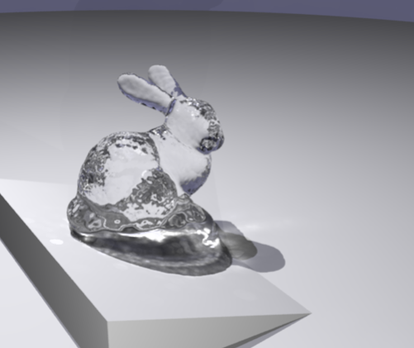
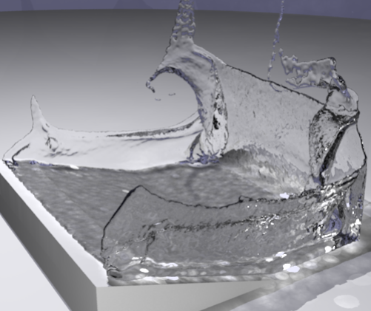
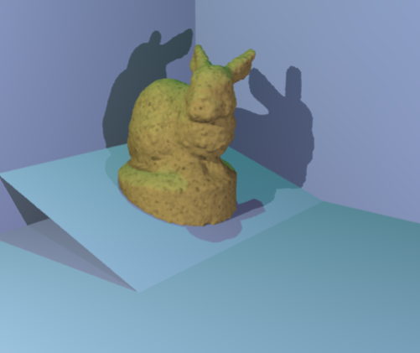
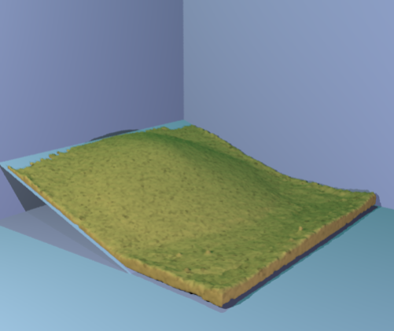
Project Description
Yongning Zhu & Robert Bridson, 2005, ACM: Animating Sand as a Fluid
Minimal Goal:
Fluid simulation with PIC and FLIP
Desired Target:
Sand simulation

Slide 3
Method PIC/FLIP Fluid Simulation
Staggered MAC grid to store fields. e.g pressure, velocity
Initialize fluid Grid cells with 8 particles per cell
Splat particle velocities to grid
Save velocities for FLIP
Apply gravity
Compute and project pressure for incompressibility
Gauss-Seidel Solver
Apply boundary conditions
Interpolate grid velocity to particles
For FLIP: Add change of velocity to particles
Advect particles: Midpoint-Euler

Slide 4
References
Open3d for visualization of particles as point cloud
Taichi: https://github.com/taichi-dev/taichi
2D PIC/FLIP solver: https://github.com/Wimacs/taichi_code
Exercise 3.collision and 4.fluids of the PBS course

Slide 5
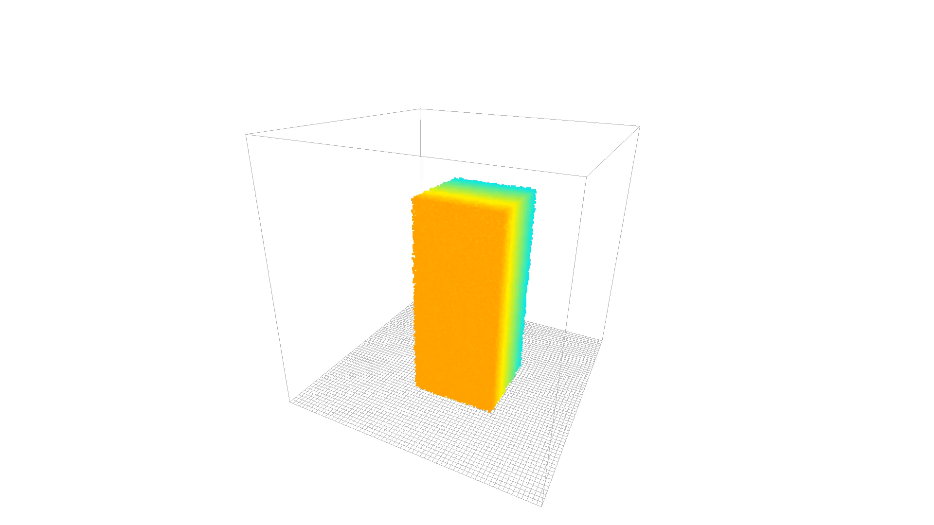
Results FLIP
Parameter | Value
Grid size | 64 x 64 x 64
Number of particles | 160’000
Time step size | 0.01

Slide 6
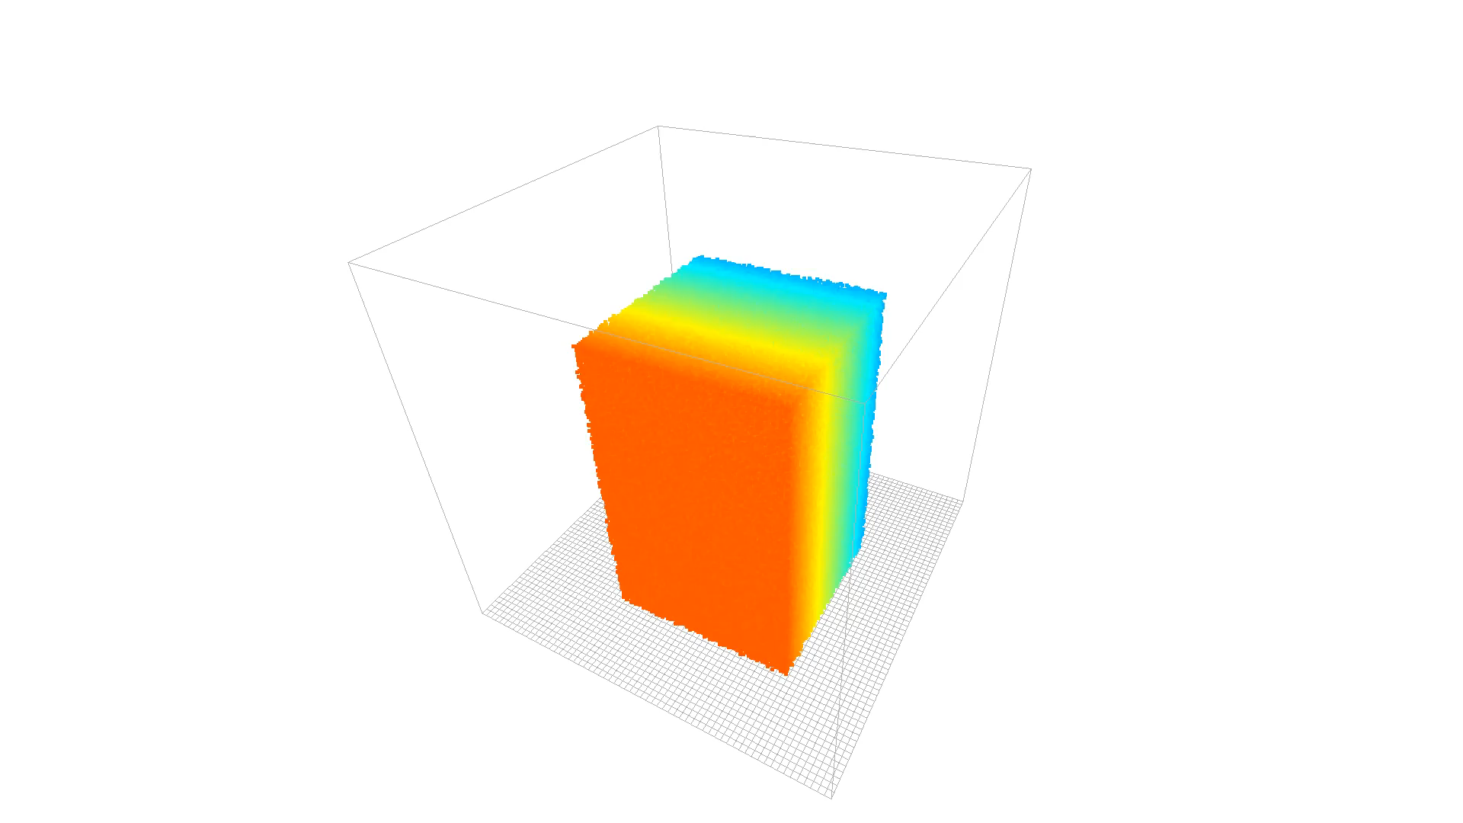
Results PIC
Parameter | Value
Grid size | 64 x 64 x 64
Number of particles | 360’000
Time step size | 0.01

Slide 7
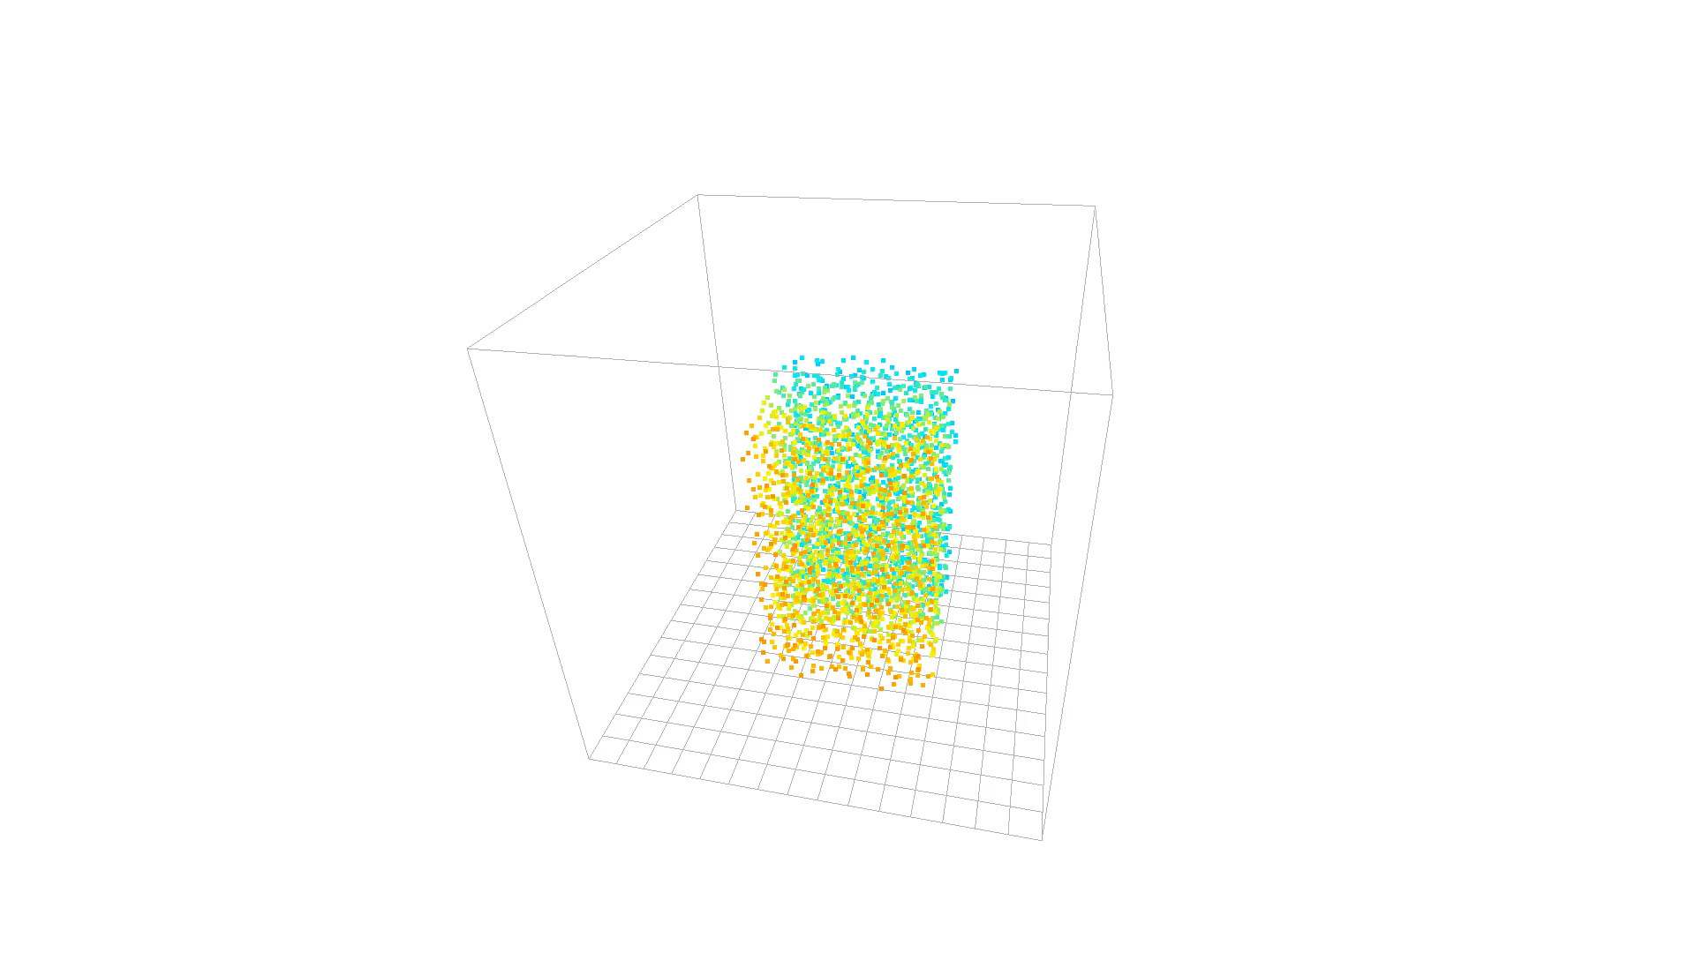
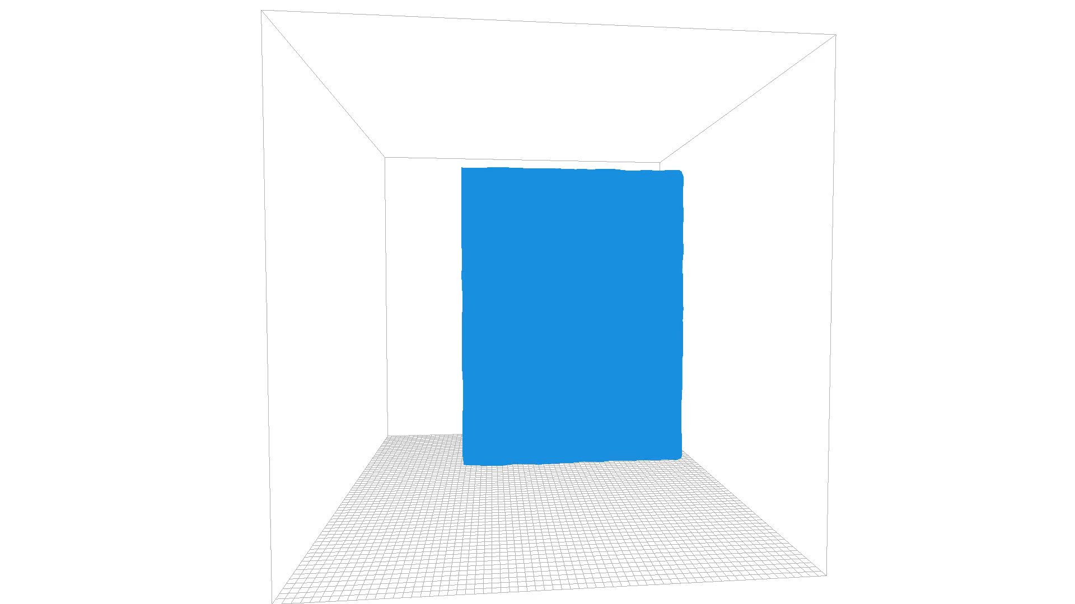
Unfinished Work
Sand Simulation
Surface Reconstruction

